Slide 1

SMART ENERGY MANAGEMENT SYSTEM
PROJECT TITLE:
- Project Proposal Presentation -

Slide 2
Module : IE2090 – Professional Engineering Practice and Industrial Management
Group number : PEP_33
Group member details :
 | STUDENT NAME | STUDENT NO. | CONTACT NO. | EMAIL ADDRESS
1 | W K T Duranga (Group leader) | IT22115584 | 0701408863 | IT22115584@my.sliit.lk
2 | P R M Chaminda | IT22549518 | 0711779853 | IT22549518@my.sliit.lk
3 | N K D Narangaspitiya | IT22555830 | 0717068199 | IT22555830@my.sliit.lk
4 | K LH D Jayalath | IT22052810 | 0761902962 | IT22052810@my.sliit.lk

Slide 3

CONTENT
Introduction
1.1. Problem Specification ………………………………………………………………………… 5
1.2. Solution Outline …………………………………………………………..……………….…... 5
1.2.1. high level architecture diagram ….……………………………………………...6
1.3. Key Benefits ………………………………………………….………..………..………………. 7
Objectives ………………………………………………………………….…………………..……..… 8
2.1. Main functions…………………………………………………….……………………………..10
Procedures
3.1 Flow of the Project (Methodology) ……………………….………………….………. 12
3.2 Project Plan (GANTT chart) …………………….……………….…………..….………… 16
Personnel and facilities………………………..…………………………………………...……. 17
Hardware, software requirements …………………………………………………….……. 19
Budget ……………………………………………………………………………………………………. 21

Slide 4
INTRODUCTION
1. Problem Specification
2. Solution Outline
high level architecture diagram
3. Key Benefits

Slide 5



Problem Specification
The current system doesn't check energy use in real-time. This leads to using energy poorly. Also, leaving unnecessary lights on and fans using too much energy without specific control makes it hard to manage and optimize energy well.
Solution Outline
Need to install a smart energy monitoring system. By focusing on a smart light and cooling systems, we can reduce unnecessary energy use and ensure better management for sustainability.
5

Slide 6

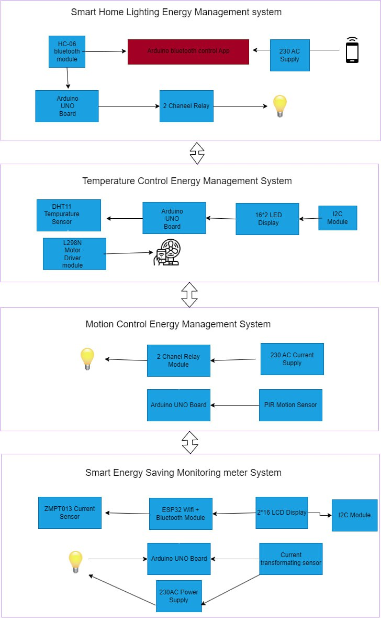
high level architecture diagram
6

Slide 7

Key Benefits
Real-Time Monitoring and Insights
Optimized Energy Consumption
Cost Savings
Enhanced Sustainability
Remote Monitoring and Control
Scalability and Flexibility
Data-Driven Decision Making
Compliance and Reporting

Slide 8
OBJECTIVES

Slide 9

Primary objective
To develop a “Smart energy management system” applicable for both home and office environments, we can utilize voice recognition technologies, Arduino-based electronics, temperature sensors, and motion sensors. This system enables individuals to reduce energy wastage and measure usage in real-time.
Sub objectives
Data collection and transmission
Temperature Monitoring and Control
Energy-Efficient Operation
Motion Detection and Activation
Automatic On/Off Functionality
Voice Recognition Integration

Slide 10
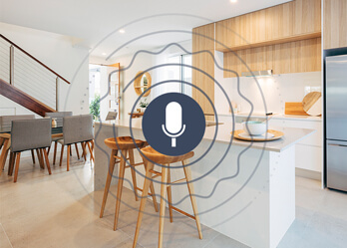
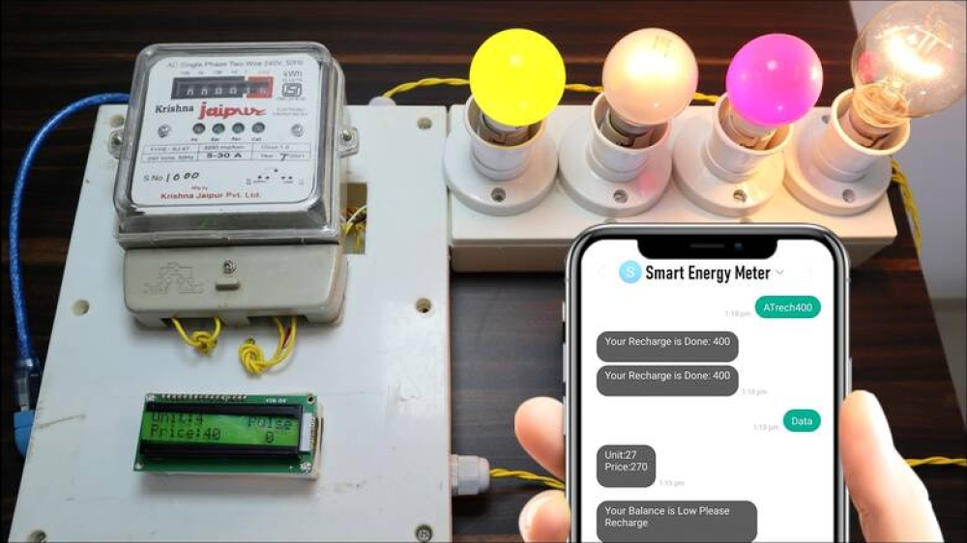
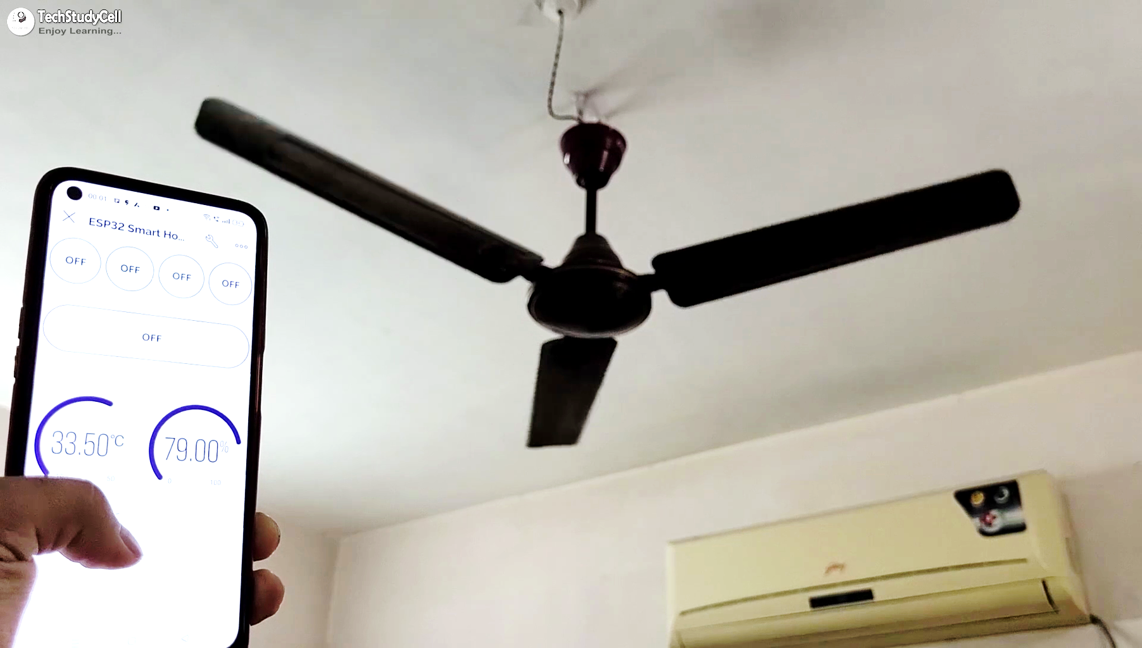
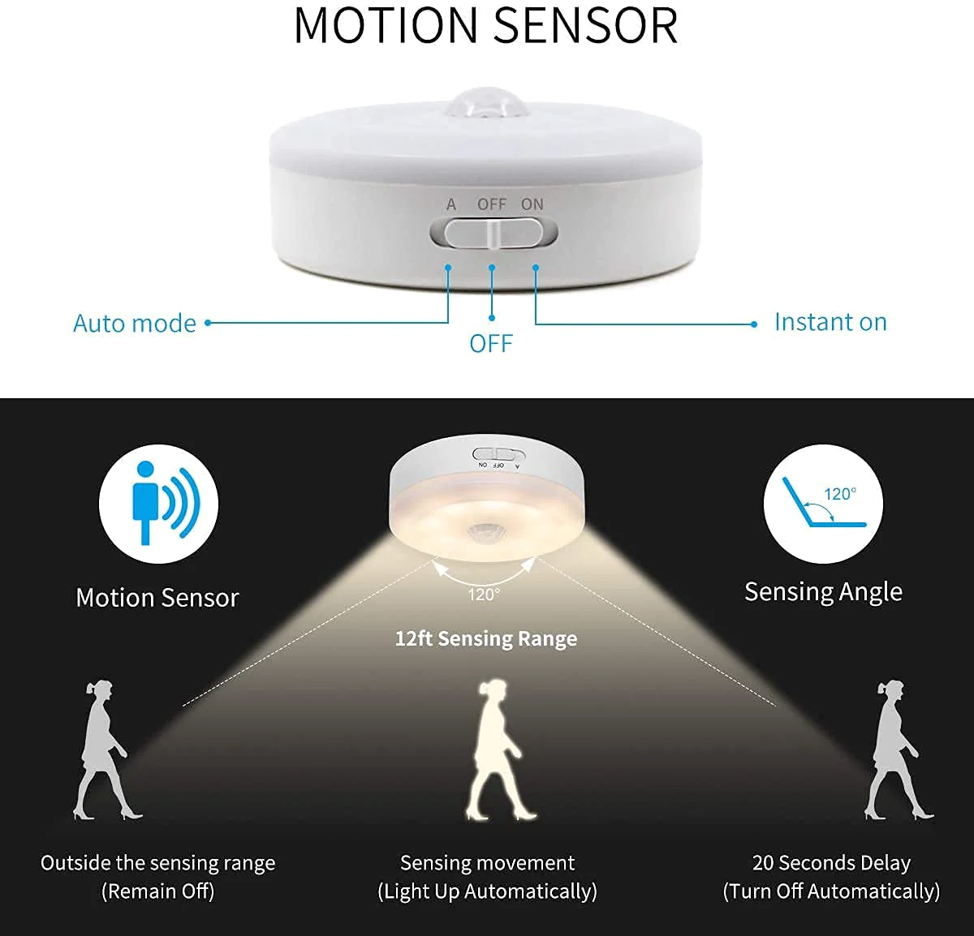
Main Functions
Voice-Controlled Light System
Arduino-Based Electric Meter
Smart Fan with Temperature Sensing
Motion Sensor Light System
Figure: 1
Figure: 2
Figure: 3
Figure: 4
10

Slide 11
PROCEDURES
Flow of the Project (Methodology)
Project Plan
(GANTT chart)

Slide 12
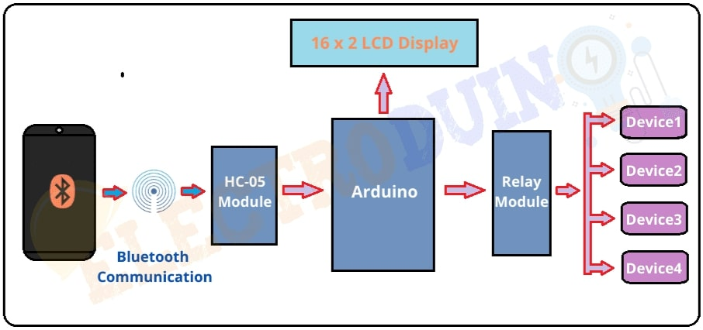
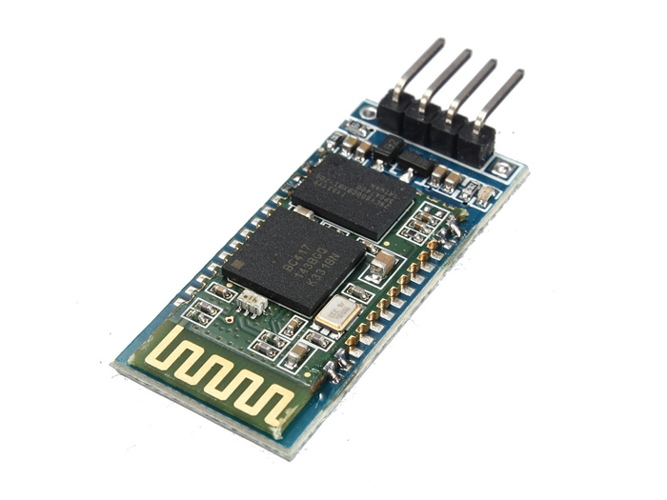
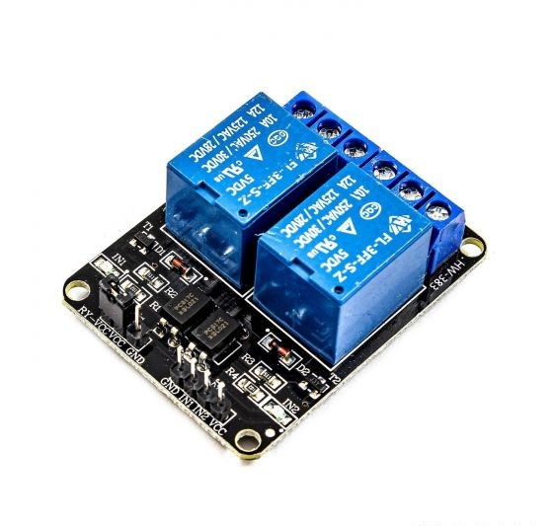
Voice-Controlled Light System
Flow of the Project (Methodology)
IT22115584 -W K T Duranga .
Problem: Electricity wastage due to unnecessarily turned-on light bulbs
Solution: a voice-controlled light system to reduce electricity costs by controlling light bulbs as needed.
Process : gathering requirements for related sensors and designing, coding, and hardware part.
Output: when giving a voice command, the bulb is turned on or stays turned off. It is fully automating the system.
HC-06
Figure: 1
Figure: 2
12

Slide 13
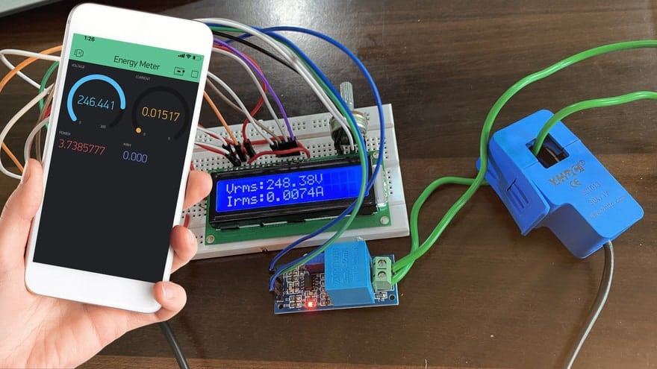
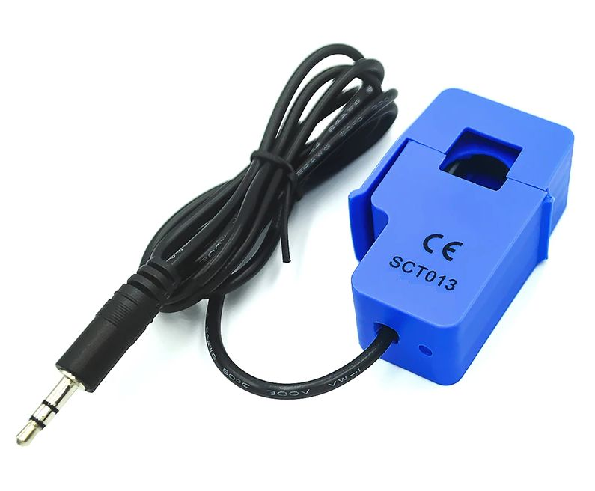
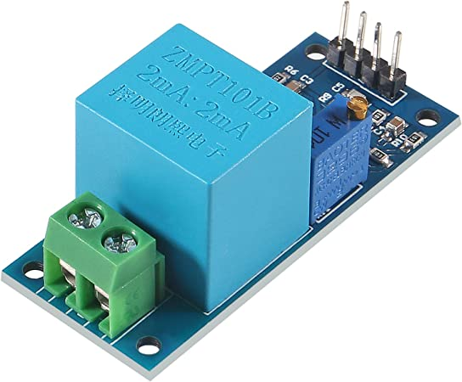
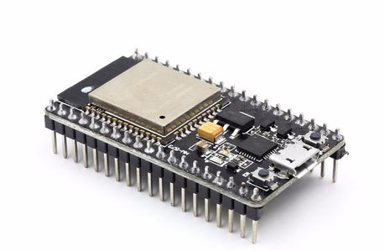
Arduino-Based Electric Meter
IT22549518 – P R M Chaminda .
Problem: Inability to efficiently measure the usage of electrical equipment
Solution: The unit cost related to the equipment used can be confirmed efficiently and effectively.
Process: designing and connecting all sensors and equipment
Output: Per unit cost, efficient energy process, and other important details are displayed on the LED panel.
Figure: 1
Figure: 2
Figure: 3
13

Slide 14
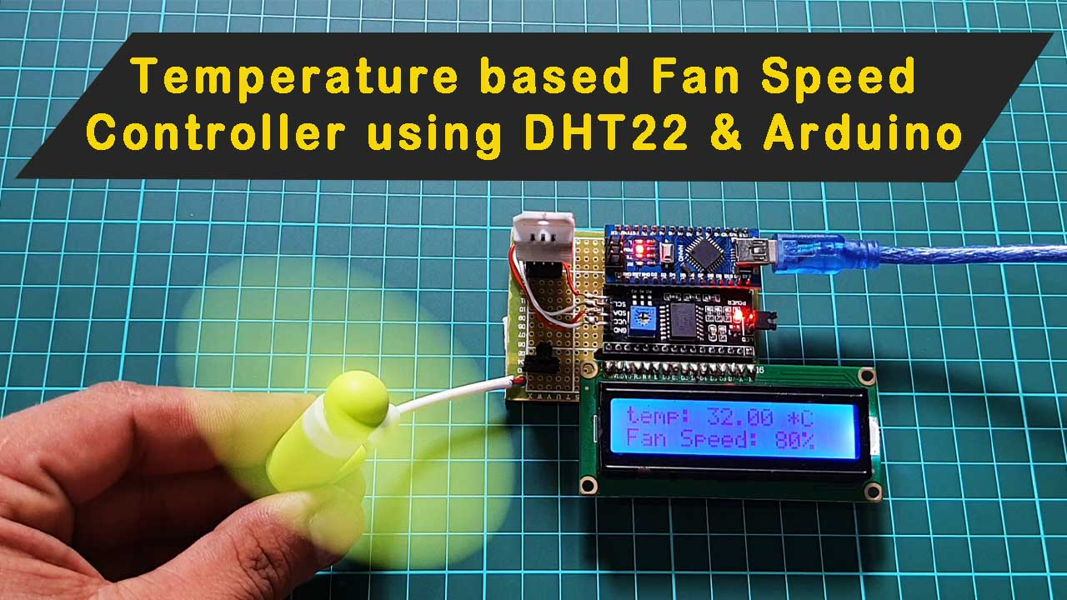
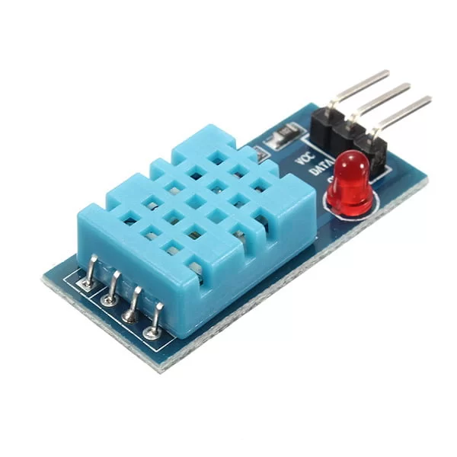
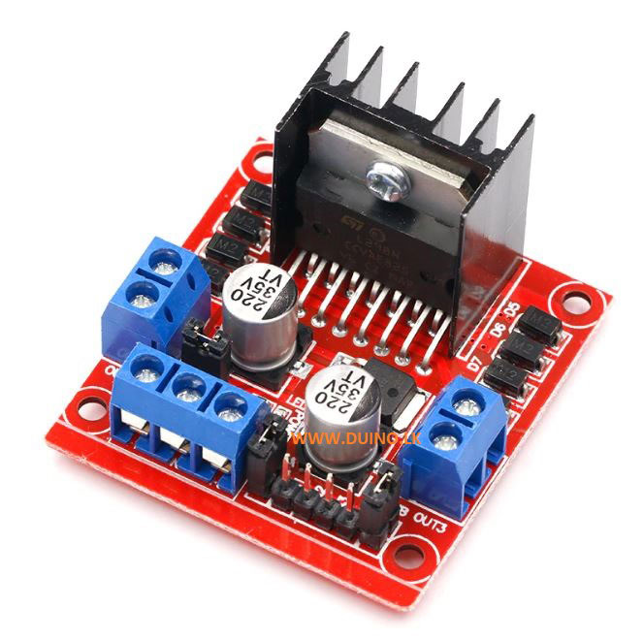
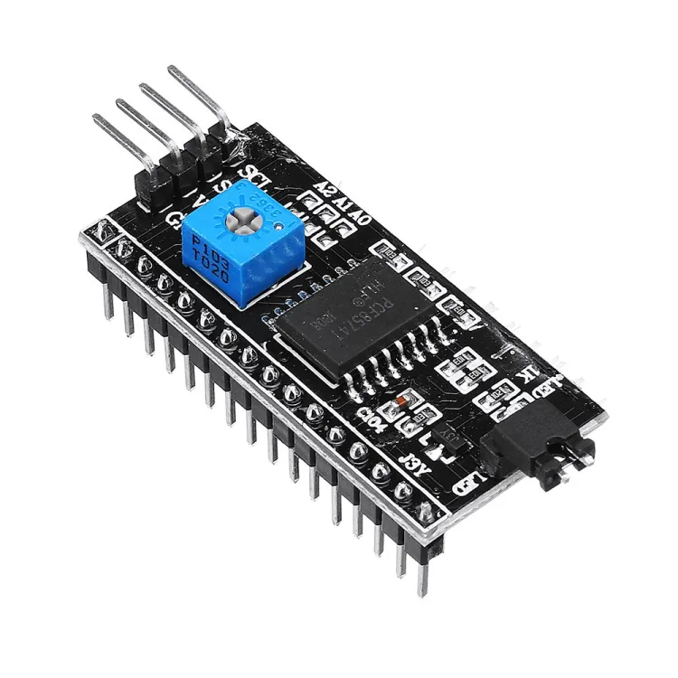
Smart Fan with Temperature Sensing
IT22555830 – N K D Narangaspitiya .
Problem: The fan wastes electricity if it is not adjusted to room temperature.
Solution: Fan speed is controlled according to the current temperature format.
Process: Designing a circuit diagram using a temperature sensor, an Arduino board, and other necessary things.
Output: Fan speed automatically changes to slow, medium, or high levels according to the temperature.
Figure: 1
Figure: 2
Figure: 3
14

Slide 15
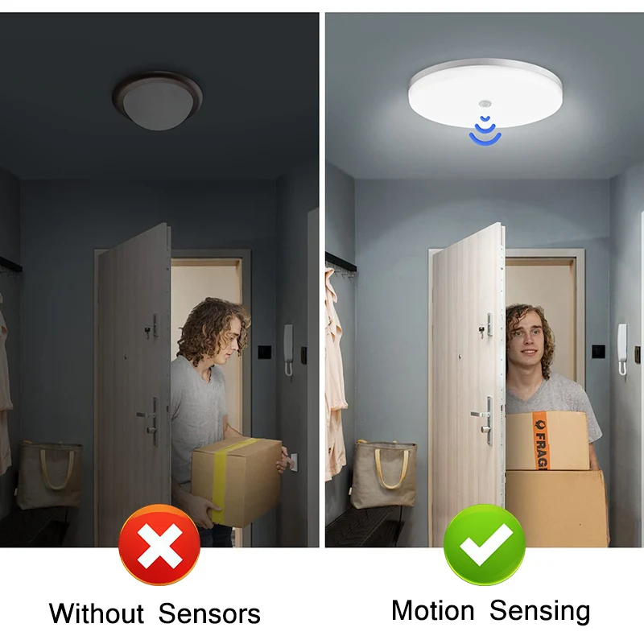
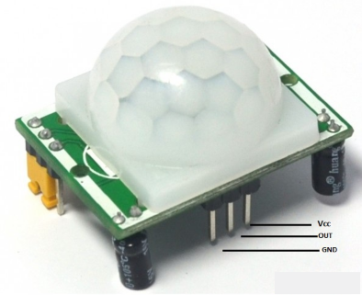
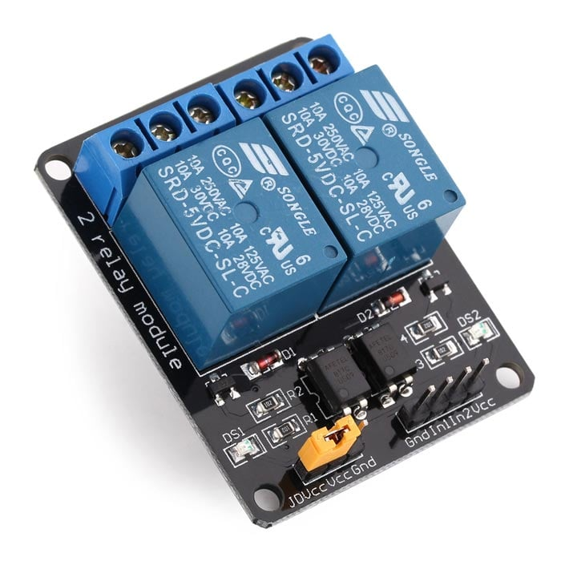
Motion Sensor Light System
IT22052810 - Jayalath K L H D .
Problem: Waste of electricity due to bulbs in stations that should not be lit all the time.
Solution: The bulb only lights up according to motion.
Process: connecting to the motion sensor, Arduino Uno board, and other equipment
Output: If someone is exposed to the sensor, it is turned on; if it is not, the bulb is off.
Figure: 1
Figure: 2

Slide 16

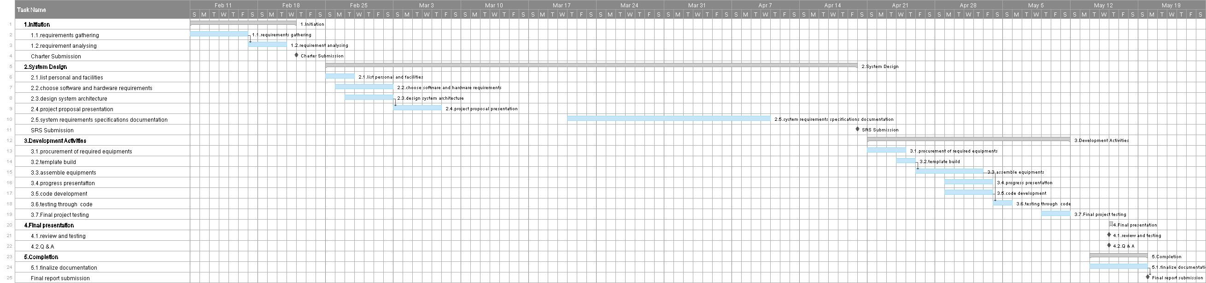
Project Plan (GANTT chart)

Slide 17
PERSONNEL AND FACILITIES
17

Slide 18
STUDENT ID / NAME | FUNCTION NAME | ROLE | FACILITES
IT22115584 - W K T Duranga | Voice-Controlled Light System | Project manager Business Analysist Designer Developer Quality Assurance(QA) | HC -06 Bluetooth wireless serial module 2 channel 5V DC relay module Bulbs and bulb holders 4pin Cable
IT22549518 – P R M Chaminda | Arduino-Based Electric Meter | Business Analysist Designer Developer QA | SCT-013 100A AC current sensor ZMPT101B sensor module ESP32 Development board – 2.4 + WIFI – Bluetooth 38 pin Wire code - 2pin Bulbs and bulb holders 16 x 2 LCD panel
IT22555830 – N K D Narangaspitiya | Smart Fan with Temperature Sensing | Business Analysist Designer Developer QA | Temperature sensor(DHT11) I298 motor driver 16 x 2 LCD display I2C module Dc motor with fan
IT22052810 – Jayalath K L H D | Motion Sensor Light System | Business Analysist Designer Developer QA | Motion sensor 2 Channel 5V relay module Plug and Wire Glue gun Bulbs and bulb holders

Slide 19
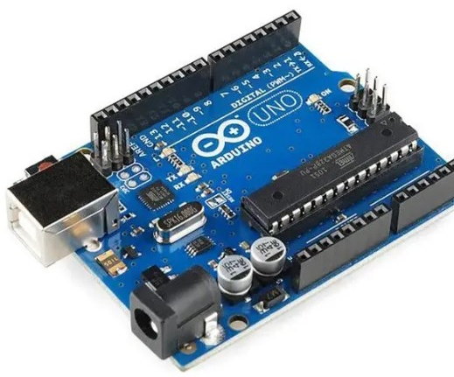


HARDWARE, SOFTWARE REQUIREMENTS

Slide 20

Hardware Requirements .
HC -06 Bluetooth wireless serial module
2 channel 5V DC relay module x2
SCT-013 100A AC current sensor
ZMPT101B sensor module
ESP32 Development board – 2.4 + WIFI – Bluetooth 38 pin
16 x 2 LCD display
Wire code - 2pin
Temperature sensor(DHT11)
I298 motor driver
I2C module
Dc motor with fan
External power supply
Motion sensor
Plug and Wire
Bread board x 4
Bulbs and bulb holders
resistors and Capacitors
Arduino uno board x4
Software Requirements ..
Development Environments:- Arduino IDE: programming
Programming Languages:- C/C++: Primary language
IoT Services
Mobile Application : - Arduino control Play Store app
Voice Control Integrations
20
20

Slide 21
BUDGET

Slide 22
Object | Budget Item | Total
1 | Arduino uno board x4 | Rs.11200
2 | 2 channel Relay modules x2 | Rs.750
3 | AC current sensor | Rs.2400
4 | Temperature sensor | Rs.300
5 | Blue tooth module | Rs.1250
6 | 2 in 16 LED panels x2 | Rs.1000
7 | Resistors and capacitors | Rs.100
8 | I2c modules x2 | Rs.1000
9 | Motion sensor | Rs.500
10 | Transportation | Rs.1500
11 | 9V battery x4 | Rs.1000
12 | Bread board x4 | Rs.1600
13 | Bulb and holders | Rs.2900
14 | Jumper wires | Rs.400
15 | Esp32 WIFI + Bluetooth module | Rs.1500
 | Total | Rs.25,900

Slide 23

Q&A

